Slide 1

Unit Testing and Modules
Error and Exception Handling, Modules, Unit Testing, Assertions
SoftUni Team
Technical Trainers
Software University
http://softuni.bg

Slide 2
Table of Contents
Error Handling
Exception Handling
Modules
Unit Testing - Concepts
Mocha and Chai for Unit Testing

Slide 3
Have a Question?
sli.do #JS-ADVANCED

Slide 4

Error Handling
Concepts, Examples, Exceptions

Slide 5
Why Error Handling is Important?
Error handling empowers the developer
Differentiates the type and reason of the error
Logs of the errors are hopeful while bug fixing
Exceptions are the object-oriented way for errors

Slide 6
Types of Errors
There are three types of errors in programming:
Syntax Errors - occur at compile time
Not applicable for JS
Runtime Errors - occur during execution
After compilation, when the application is running
Logical Errors - occur when a mistake has been made in the logic of the script and the expected result is incorrect
Also known as bugs

Slide 7
Error Handling
A function failed to do what its name suggests should:
Return a special value (e.g. undefined / false / -1)
Throw an exception / error
let str = "Hello, SoftUni";
console.log(str.indexOf("Sofia")); // -1
// Special case returns a special value to indicate "not found"

Slide 8
Error Handling
The fundamental principle of error handling says that a function (method) should either:
Do what its name suggests
Indicate a problem
Any other behavior is incorrect

Slide 9
Error Handling - Exceptions (Errors)
Exception - a function is unable to do its work (fatal error)
let arr = new Array(-1); // Uncaught RangeError
let bigArr = new Array(9999999999); // RangeError
let index = undefined.indexOf("hi"); // TypeError
console.log(George); // Uncaught ReferenceError
console.print('hi'); // Uncaught TypeError

Slide 10
Error Handling - Special Values
let sqrt = Math.sqrt(-1); // NaN (special value)
let sub = "hello".substring(2, 1000); // llo
let sub = "hello".substring(-100, 100); // hello
// Soft error - substring still does its job: takes all available chars
let invalid = new Date("Christmas"); // Invalid Date
let date = invalid.getDate(); // NaN

Slide 11
Unexpected Behavior
In JavaScript, the first month (January) is month number 0, so December returns month number 11
let date = new Date(2016, 1, 20); // Feb 20 2016
let date1 = new Date(1, 1, 1); // Feb 01 1901
let dateMinus1 = new Date(-1, -1, -1); // Nov 29 -2
let dateNext = new Date(2016, 1, 30) // Mar 01 2016 (next month)
let datePrev = new Date(2016, -1, 30); // Dec 30 2015 (prev month)

Slide 12

Exception Handling
Throwing / Catching Errors

Slide 13
Throwing Errors (Exceptions)
The throw statement lets you create custom errors
General Error - throw new Error("Invalid state")
Range Error - throw new RangeError("Invalid index")
Type Error - throw new TypeError("String expected")
Reference Error - throw new ReferenceError("Missing age")
Good practices say that you should use Error when throwing

Slide 14
Try - catch
The try statement tests a block of code for errors
The catch statement handles the error
Try and catch come in pairs
try { // Code that can throw an exception // Some other code - not executed in case of error!
}
catch (ex) { // This code is executed in case of exception // Ex holds the info about the exception }

Slide 15
Exception Properties
An Error object with properties is be created
try {
throw new RangeError("Invalid range.");
console.log("This will not be executed.");
} catch (ex) {
console.log("Exception object: " + ex);
console.log("Type: " + ex.name);
console.log("Message: " + ex.message);
console.log("Stack: " + ex.stack); }

Slide 16

Modules
Definition, Import, Export

Slide 17
Modules
A set of functions to be included in applications
Group related behavior
a module for loading indicator will look like:
Resolve naming collisions
http.get(url) and students.get()
Expose only public behavior
They do not populate the global scope with unnecessary objects
const loading = {
show() { }, hide() { },
};

Slide 18
Approaches for modules
Since, modules were not native in JS, there are different approaches to create modules:
Using IIFE
Using Nodejs require/export
Using ES2015 import/export

Slide 19
IIFE Modules
IIFE modules are essential for front-end JS
They hide the unnecessary and expose only needed behavior/objects to the global scope
(function(scope) {
const selector = 'loading'; const loadingElement = document.querySelector(selector) const show = () => loadingElement.style.display = ''; const hide = () => ladingElement.style.display = 'none' // Only this is visible to the global scope scope.loading = { show, hide };
}(window));

Slide 20
Node.js Modules
require() is used to import modules
Internal modules need to be exported before being required
In Node.js each file has its own scope
const http = require('http');
// For NPM packages
const myModule = require('./myModule.js');
// For internal modules

Slide 21
Node.js Modules
Whatever value has module.exports will be the value when using require
To export more than one function, the value of module.exports will be an object
const myModule = () => {...};
module.exports = myModule;
module.exports = { toCamelCase: convertToCamelCase, toLowerCase: convertToLowerCase };

Slide 22
ES6 Modules
Always import and export an object
Only a specific function can be imported
To import the whole object
To change the name after importing
import toLowerCase from './toLowerCase.js';
import * as myModules from './myModules.js';
import { toLowerCase as convertToLowerCase } from './myModules.js';

Slide 23

Unit Testing
Definition, Structure, Examples, Frameworks

Slide 24
Unit Testing
A unit test is a piece of code that checks whether certain functionality works as expected
Allows developers to see where & why errors occur
function sortNums(arr) { arr.sort((a,b) => a - b); }
let nums = [2, 15, -2, 4]; sortNums(nums);
if (JSON.stringify(nums) === "[-2,2,4,15]") { console.error("They are equal!");
}

Slide 25
Unit Testing
Testing enables the following:
Easier maintenance of the code base
Bugs are found ASAP
Faster development
The so called "Test-driven development"
Tests before code
Automated way to find code wrongness
If most of the features have tests, running them shows their correctness

Slide 26
Unit Tests Structure
The AAA Pattern: Arrange, Act, Assert
// Arrange all necessary preconditions and inputs
let nums = [2, 15, -2, 4];
// Act on the object or method under test
sortNums(nums);
// Assert that the obtained results are what we expect
if (JSON.stringify(nums) === "[-2,2,4,15]") {
console.error("They are equal!");
}

Slide 27

Unit Testing Frameworks
JS Unit Testing:
Mocha, QUnit, Unit.js, Jasmine
Assertion frameworks (perform checks):
Chai, Assert.js, Should.js
Mocking frameworks (mocks and stubs):
Sinon, JMock, Mockito, Moq

Slide 28

Mocha and Chai
Unit Testing with Mocha and Chai

Slide 29
What is Mocha?
Feature-rich JS test framework
Provides common testing functions including it, describe and the main function that runs tests
Usually used together with Chai
describe("title", function () {
it("title", function () { … });
});

Slide 30
What is Chai?
A library with many assertions
Allows the usage of a lot of different assertions such as assert.equal
let assert = require("chai").assert;
describe("pow", function() {
it("2 raised to power 3 is 8", function() {
assert.equal(pow(2, 3), 8);
});
});

Slide 31

Mocha and Chai
Global Installation

Slide 32

Global Installation
To install frameworks and libraries globally, use the CMD
Installing Mocha and Chai through npm
Check if Mocha is installed
npm install –g mocha
npm install –g chai
mocha --version

Slide 33
NODE_PATH Configuration
By default Node.js does not find its globally installed modules
You need to set the NODE_PATH environment variable
You may need to restart your IDE after changing NODE_PATH
rem for any future sessions
setx NODE_PATH %AppData%\npm\node_modules
rem for current session
set NODE_PATH=%AppData%\npm\node_modules

Slide 34
Usage and Examples
To load a library, we need to require it
const expect = require("chai").expect;
describe("Test group #1", function () {
it("should… when…", function () {
expect(actual).to.be.equal(expected);
});
it("should… when…", function () { … });
});
describe("Test group #2", function () {
it("should… when…", function () {
expect(actual).to.be.equal(expected);
});
});

Slide 35

Test Driven Development
Learn the "Test First" Approach to Coding

Slide 36
Unit Testing Approaches
"Code First" (code and test) approach
Classical approach
"Test First" approach
Test-driven development (TDD)

Slide 37
The Code and Test Approach
Write code
Write unit test
Run and succeed
Time flow

Slide 38
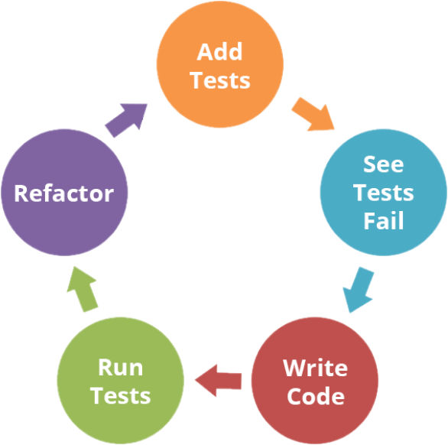
The Test-Driven Development Approach

Slide 39
Test-Driven Development (TDD)
Create a test list
Pick а test
Write test
Compile and fail
Write enough code to compile
Run test and fail
Write code to pass test
Time flow
Remove duplication

Slide 40

Why TDD?
TDD helps find design issues early
Avoids reworking
Writing code to satisfy a test is a focused activity
Less chance of error
Tests will be more comprehensive than if they are written after the code

Slide 41

Live Exercises
Unit Testing

Slide 42

Summary
…
…
…
A function should do what its name suggests
The throw statement lets you create custom errors
Modules are a set of functions to be included in applications
Unit tests check if certain functionality works as expected

Slide 43
https://softuni.bg/courses/js-advanced

Slide 44












SoftUni Diamond Partners

Slide 45




SoftUni Organizational Partners

Slide 46




Trainings @ Software University (SoftUni)
Software University – High-Quality Education and Employment Opportunities
softuni.bg
Software University Foundation
http://softuni.foundation/
Software University @ Facebook
facebook.com/SoftwareUniversity
Software University Forums
forum.softuni.bg

Slide 47

License
This course (slides, examples, demos, videos, homework, etc.) is licensed under the "Creative Commons Attribution-NonCommercial-ShareAlike 4.0 International“ license

